Slide 1

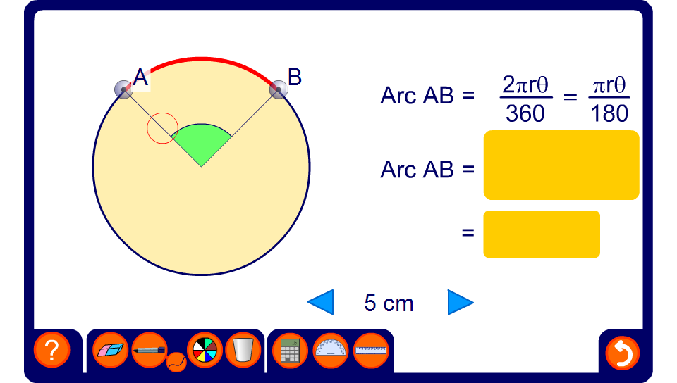


Finding the length of an arc
Notes:
Reveal the size of the angle and the length of the radius and ask pupils to find the length of the arc.
Change these values to give a new problem.
Extend the activity by hiding the angle at the centre of the circle. Reveal the length of the arc and ask pupils to find the unknown angle using the formula.

